Slide 1
Check
Can you explain what a Subroutine is?
Can you describe the advantages of Subs?
Can you write a Subroutine with parameters?
Can you write a Subroutine without parameters?

Slide 2
Functions

Slide 3

Definition
Function:
a sequence of commands or programming code that returns a value (sends a result back).
Functions usually "take in" data, process it, and "return" a result.
Question:
How is a Function different to a Procedure?

Slide 4
Procedures & Functions
are blocks of code in your program that are called upon from other parts of your program.
are the building blocks of a program and provide a way to organise and modularise your code.
Similarity:
Both can be called with or without parameters
VB.NET:
Procedure (known as Subroutine in PL):
does not have to produce a return value (does not use the Return keyword)
Function: does produce a return value (using the Return keyword)
Adv:
Re-use code: create a common routine once and re-use as many times as you want
Structure your programming/code
Share code with other programs, i.e. easily incorporate other peoples code
Test subroutines/functions independently of the rest of the code
Reduces need for global variables as local variables used instead

Slide 5
Common Exam Questions
What is the difference between a function and a procedure?
Functions return values, Procedures does not have to return a value ** Note: return = using Return keyword
Why would you use subroutines (functions and procedures) in your code?
structure your code
create a common routine once and re-use as many times as you want
share code with other programs
test subroutines/functions independently of the rest of the code

Slide 6
Calling a Function
To call a Function, the syntax is identical to an assignment statement that uses a VB built-in function:
VariableName = FunctionName(argument list)
For example, if we made a function called "AddEm" that returned a value (like the sum, for example), we could invoke the function as follows:
intSum = AddEm(intNum1, intNum2)
The above statement would cause the following to happen:
The function AddEm would be called, passing intNum1 and intNum2
The AddEm function would add the values of intNum1 and intNum2 to produce its return value, the sum.
When the AddEm funciton exits, its return value would be stored in the variable intSum

Slide 7
Calling a Function
Sub Main( )
[statements; inc. declaring Var]
Var = FunctionName(with argument)
[statements]
End Main
---------------------------------------------------------------------------------------------------------------
[Public] Function FunctionName[(parameter list)]
[statements]
Return variable or formulae
[statements]
End Function

Slide 8
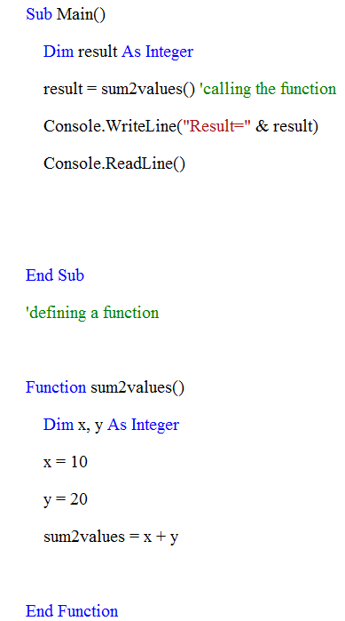
Example1: Calling a Function (without parameters)
Code:
Note:
The name of function must start with a letter or underscore not a number
Note: Here we assign a formula to the function name, instead of using the return statement (return sum2values and new variable to add the numbers within the function ) as there are no parameters in function call

Slide 9
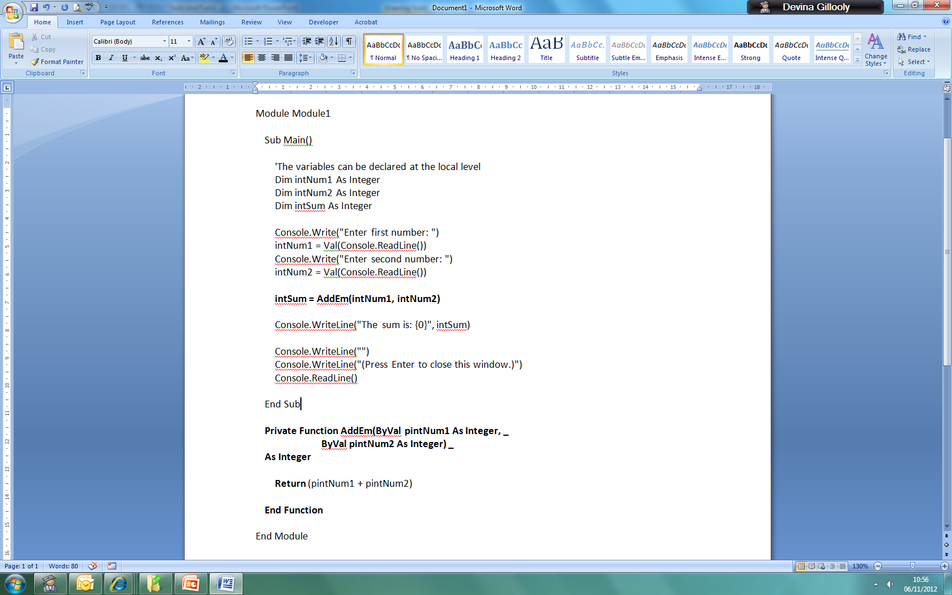
Example2: Calling a Function (with parameters) 55
Note:
Return statement consists of a formulae; this could be replaced with: Return sum, as shown below:
Function AddEm (ByVal……)
Dim sum As Integer
sum = pintNum1 + pintNum2
Return sum
End Function

Slide 10
Function
Additional Notes
Note that to return a value from a function, you can either assign the value to the function name or include the function name in a Return statement.
When you assign the return value to the function name, any statements following the assignment statement will be executed before returning to the caller.
When you assign the return value using the Return statement, control will immediately return to the caller and any remaining statements in the function procedure will be ignored.
As when calling a Sub, the items passed in the argument list of the call to the Function must match the parameter list of the Function header in number and data types. The data type of the return value must match the data type of the target variable name in the assignment statement that calls the Function.

Slide 11
Functions returning a value
A function can return one or more values using a RETURN statement
Compare the code below. How are they different?
SUB multiply(x,y)
print “Product:”
print x*y
END SUB
#main program
multiply(2,5)
Func multiply(x,y)
product ← x*y
RETURN product
END FUNC
#main program
answer ← multiply(2,5)
print “Product:”
print answer

Slide 12
Summary
Declarations
Calls
Subroutine | Function
Sub printNumber() console.writeline(number1) End Sub | Function printNumber() Dim number1 As integer = 5 return number1 End Function
 | Function printNumber() printNumber = number1 End Function
Subroutine | Function
printNumber() ' a procedure call | x = printNumber() ' assigned to a variable

Slide 13
Summary
Subroutine
'declaration Sub printNumber(ByVal number1 As Integer) 'one parameter [statements] console.writeline(number1) End Sub '... 'call printNumber(number1) ‘printing the number 4
Function
'declaration function squareNumber(ByVal number1 As Integer) 'one parameter return (number1 * number1) End Function '... 'call Variable = squareNumber (number1)

Slide 14
Check
Can you explain what a Subroutine is?
Do you know the difference between a Sub & a Func?
Can you describe the advantages of Funcs & Subs?
Can you write a Subroutine with parameters?
Can you write a Subroutine without parameters?
Can you write a Function with parameters?
Can you write a Function without parameters?

Slide 15
Plenary Question
Class Task
Program the task on the handout.
Complete the exercise on the handout.
Write a function declaration with the identifier of Avg that will accept 3 numbers (num1, num2, num3) and return the average:
Function Avg(ByVal num1 As Integer, ByVal num2 As Integer, ByVal num3 As Integer)
Return ((num1+num2+num3)/3)
End Function
Additional Reading: Using array as function argument

Slide 16
Independent Work (mandatory)
Describe briefly three advantages of using subroutines in programs. [6]
2. A primary school teacher requires a program that will allow pupils to practise their multiplication tables (times tables). The program must allow them to choose the table they want displayed and the start and end numbers to multiply by.
For example, if the pupil enters 5, 4, 12 the program will display
5 x 4 = 20
5 x 5 = 25
…
…
5 x 12 = 60
The program will then print a message followed by the table selected.
Create a solution for this using a subroutine called multiples() which takes table, startnum, endnum and pupilName as parameters. The subroutine will output the message and multiplication table. The main program will prompt the user to enter the values and will then pass them to the routine.

Slide 17
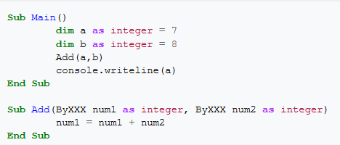
Independent Work
1. Answer the following exam questions:
What is the difference between a function and procedure? [2]
What is the difference between a parameter passed by Value and a parameter passed by Reference? [2]
2.
What is the output of the above code when ByXXX = ByVal ? [1]
What is the output of the above code when ByXXX = ByRef? [1]
Notes:
Qwkbs

